Slide 1
Team and agile @ni

Slide 2
AGILE SCRUM METHODOLOGIES
TRADITIONAL AGILE VS MY COMPANY’S AGILE
WILL GO THROUGH THE MEETINGS WE HAVE AND COMPARE
WILL GO THROUGH TEAM STRUCTURES AND COMPARE
HOW DO WE DO POINTING TICKETS

Slide 3
Traditional Agile
Product Backlog
Sprint Backlog
Sprint Planning
Daily Stands (Development)
Sprint Review
Sprint Retrospective
My Company’s Agile
Project Backlog
Sprint Planning
We combine backlog and planning
Sprint Backlog
Daily Stands (Development)
Sprint Review
Maybe after every deploy, but not after every sprint
Sprint Retrospective (once)

Slide 4
What is a Product Backlog
The product backlog is a priority list of user requirements and consists of USER STORIES.
Use cases to be done in order to create, maintain and sustain a product
Product Owner owns the product backlog, (s)he is the one who prioritize it based on the customers feedback or business value.
It is a very active document where all the wish list and user requirements are gathered
Product owner makes sure that content of product backlog “user stories” are defined in detailed level
Each user story in product backlog should be enough in sizing to be fit in one sprint

Slide 5
What is sprint backlog
Sprint backlog is the subset of the product backlog.
Each sprint, scrum team picks the user stories from product backlog on top of its stack
The number of user story picked by scrum team for a time box sprint is based on the average velocity of a scrum team.
Sprint backlog is dynamic in nature, each sprint the above scenario is repeated.
VELOCITY: Number of story points delivered/demo in a Sprint is called velocity.
For example, if team planned 30 story point(Business value) worth of user stories in a sprint and able to deliver as planned then team's velocity is 30.
CAPACITY: Total number of available hours for a sprint is called Team's Capacity
Available hours calculated based on resources planned holiday and company holiday if any.

Slide 6
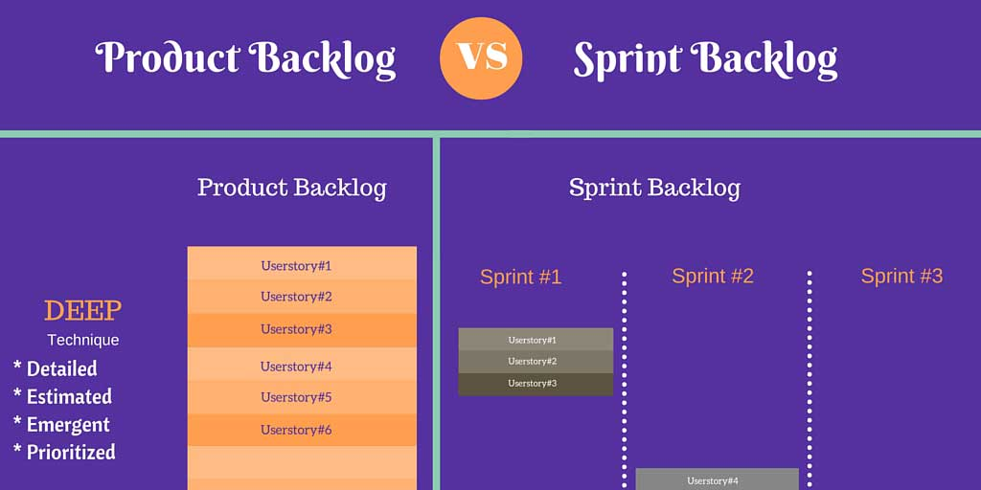

Slide 7
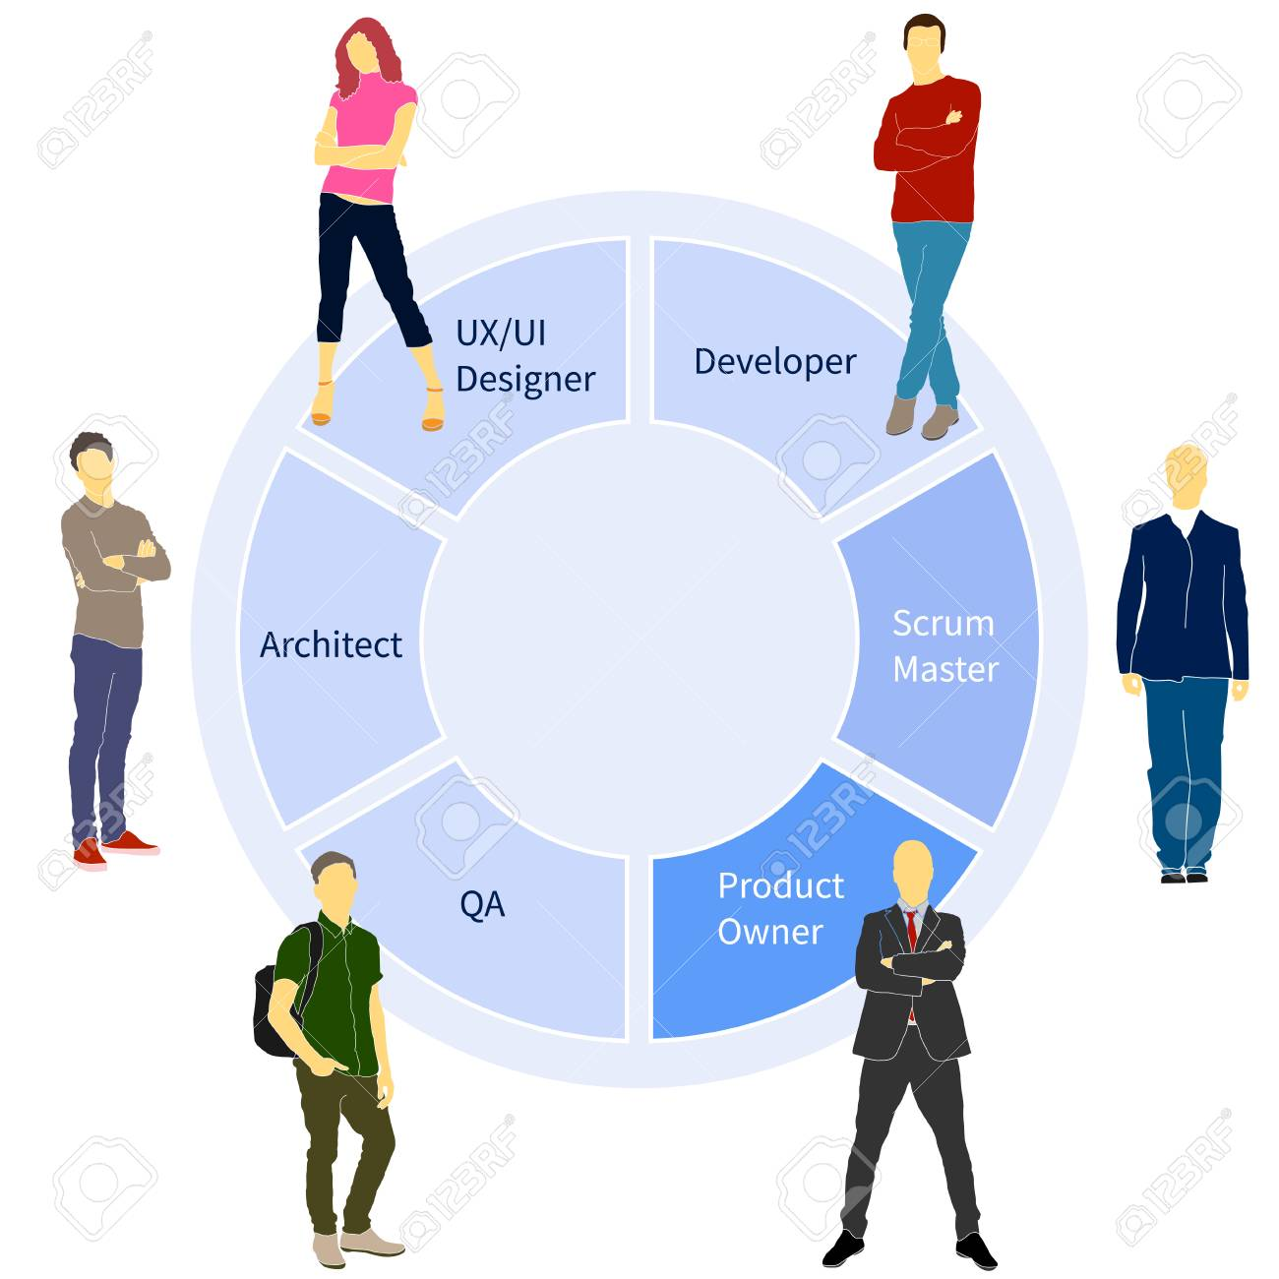
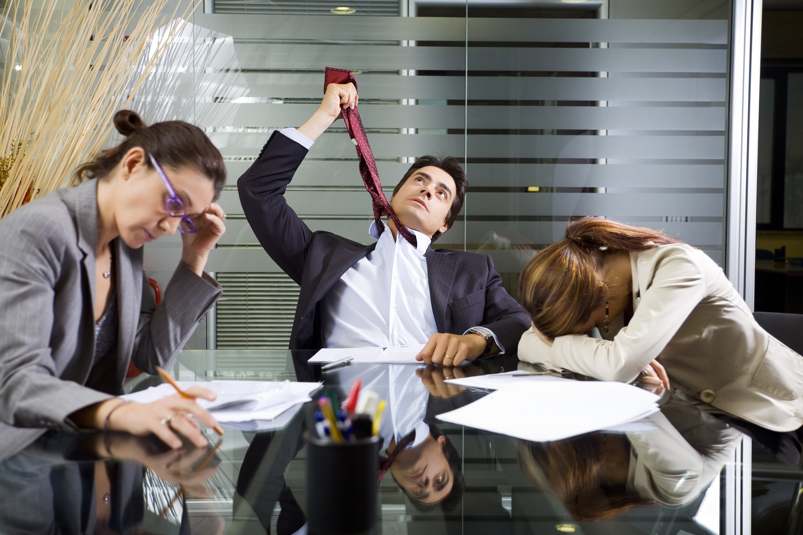
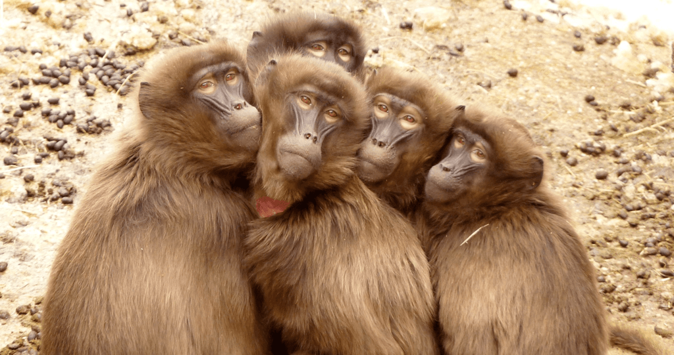

Traditional Agile Team
(can contain)
Product Owner
UI/UX Designer
Scrum Master
Project Manager
Developers
Architect
QA
My Team
PRODUCT MANAGER (Product Ninja)
Developers (4-5)
QA Engineer (2)
Product Owner
UI/UX Designer
Scrum Master:(are we getting a scrum master)
Project Manager
Architect
https://www.builtinchicago.org/2018/08/23/spotlight-working-at-networked-insights-leader-vision

Slide 8
Sprint Planning
We go through backlog with Product Manager, AND pull tickets to the upcoming sprint.
We point the tickets. That’s it.
Story : Calling Esen.
Daily Stands
Everyday
3 times a week
2 times a week
Sometimes Slack stand

Slide 9
Sprint review
Each sprint is required to deliver a potentially shippable product.
This means that at the end of each sprint, the team has produced a coded, tested and usable piece of software.
So at the end of each sprint, a sprint review meeting is held
The sprint review meeting is intentionally kept very informal
A sprint review meeting should not become a distraction or significant detour for the team; rather, it should be a natural result of the sprint.
TLDR; Team compares actual results of sprint vs expected results of sprint. Ideally, the team is completed each product backlog item brought into the sprint. BUT it is more important that they achieve the overall goal of the sprint.

Slide 10
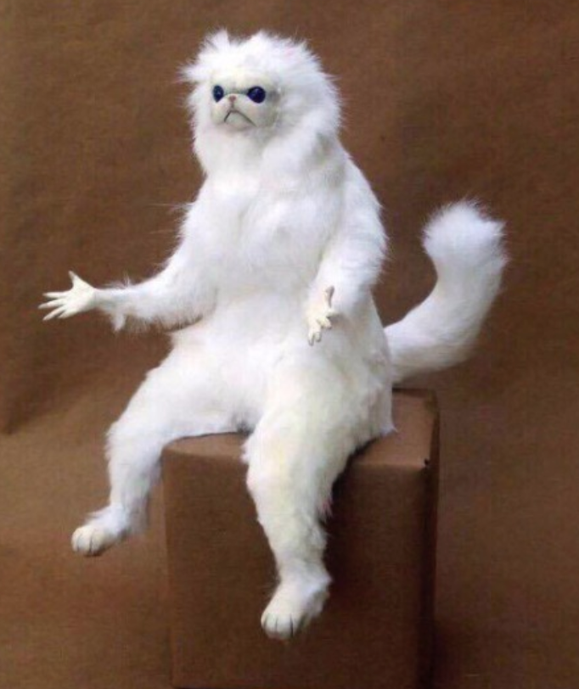
SO YOU HAD:
UNLIMITED PTO
UNLIMITED WFH
UNLIMITED SICK&PERSONAL DAYS
ONLY HALF OF THE AGILE CEREMONIES
DID YOU ACTUALLY WORK AND DEVELOP ANYTHING??

Slide 11
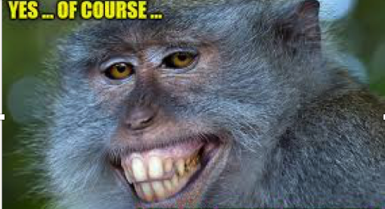
YES!
We developed 2 different brand new products, that are selling very well now.

Slide 12
Sprint Retrospective
The goal of the retrospective is for the team members to discuss among themselves about how the work went during the last sprint so that better ways can be found to meet the project’s goals
What we did good
Who did what good
What did we do BAD. ⬅ NO
What we could have done better. ⬅ YES
Example from work: Daily stands getting too technical.

Slide 13
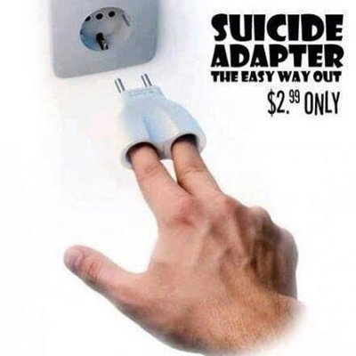
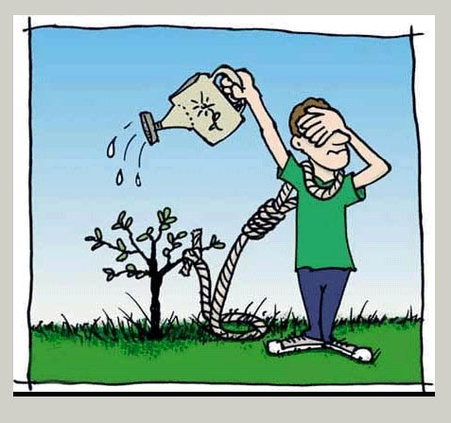
Tell what you think without criticizing someone by name
Hey John you suck at coding. You need to be faster man, I can’t do the testing in just last day.
If we could have a few more days for test, I think I could be more thorough & detailed with my testing.
Don’t be negative, don’t suicide your career

Slide 14
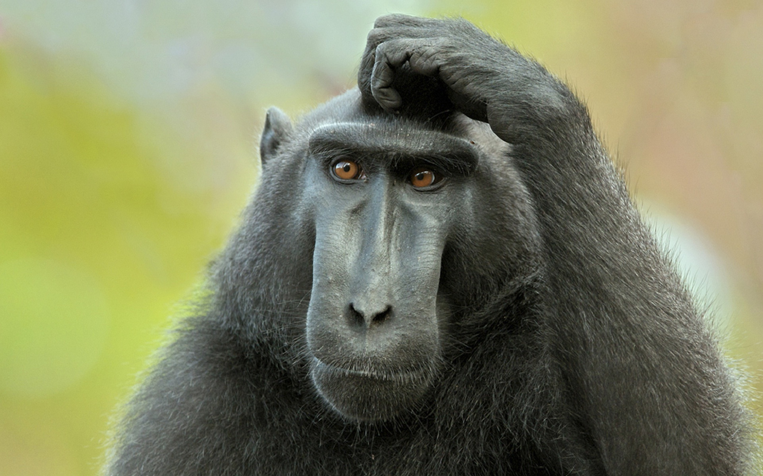
Does this* make my company more agile or less agile?
*: “not having all the components of agile ceremonies & team”

Slide 15
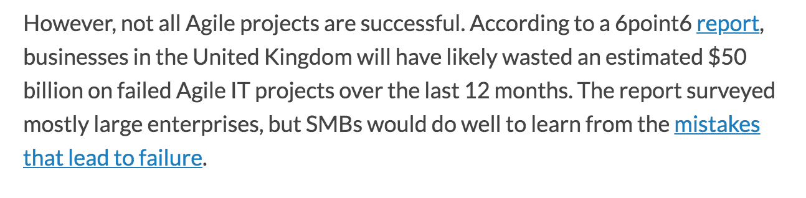
In my opinion!
Yes! It does make the company more agile to skip some of the ceremonies.
What is the whole purpose of agile?
AGILE DICTIONARY MEANING: “able to move quickly and easily”
So if you are skipping some ceremonies, whilst applying agile and succeeding, skipping unnecessary things is MORE agile.
Link: https://blog.capterra.com/sprint-planning-blunders/

Slide 16
What is point and why pointing?
Abstract measure of effort required to implement a user story
In simple terms, it is a number that tells the team about the difficulty level of the story
Why pointing? (to estimate)
Tentative (unsure, uncertain, hesitant 3)
Agile uses Fibonacci series
1, 2, 3, 5, 8, 13, 21, …
Example from work: When I first started…
We didn’t do planning poker.

Slide 17
My understanding of agile
To anticipate change and allow for flexibility in development of the application
You expect some drawbacks and be prepared for it.
To keep the team up to date and on the same page at all times (e.g. daily stands)
Flexibility and fast decision making allows changes and errors to be fixed faster, thus results in spending less time ➔ lowering the cost
Low cost + More precise product = Satisfaction

Slide 18
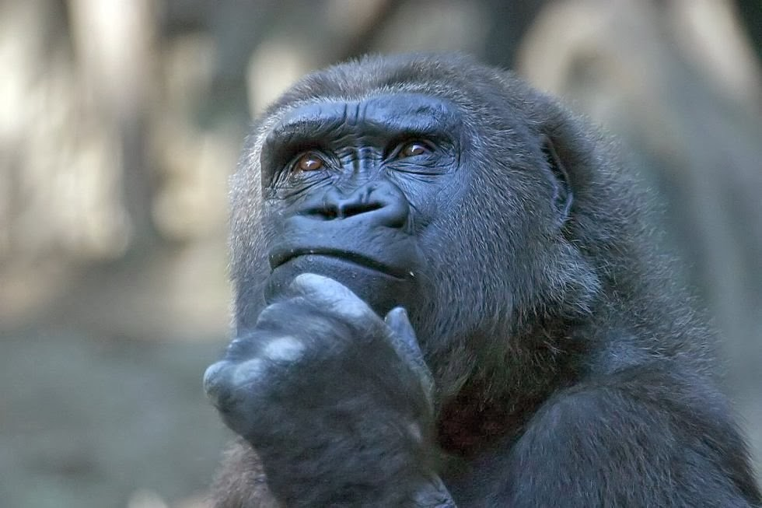
Questions?

